Slide 1

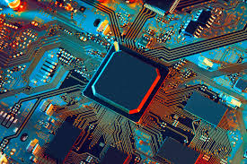

ASIC project
Thales-IMS Marvyn Pannetier
Expiquer ce que j’ai fait
Formation flot FPGA numérique (VHDL, Xillinx vivado)
Formation flot ASIC numérique (DC, EDI candence, script TCL, Modelsim, redaction d’un petit doc récap)
Capitaliser infos ASICAGE analogique et possibilité avec THALES-IMS

Slide 2
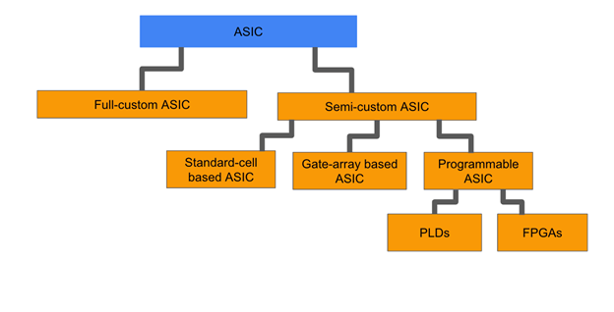
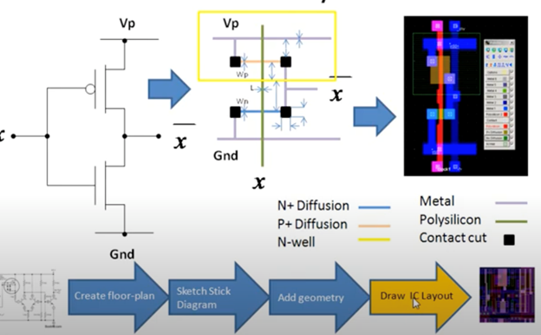
1 – ASIC type
PDK free
IP catalog (components already ready but not optimized)

Slide 3
2 - Technologies
 | Pros | Cons
X-FAB | Used by THALES and IMS Present in France
ST | Strong resources at IMS Present in France | Could be difficult to use at Thales
ONSEMI | Used at THALES
TSMC
La quelle de pref?
PDK-Xfab accessible à thales?

Slide 4

3 - Tools
Cadence Virtuoso (schematic, placement and routing by hand)
PDK (process design kit): contains layouts and manufacturing rules. Given for free by the founder.

Slide 5
4 – Costs
X-FAB prototyping services
CMP (Circuits Multi-Projets®) for ST, Onsemi, AMS
Thales mm2 cost? (65nm ST 3000€)
1 million dollar to launch a project
Cost : development(Tools/softs,time…etc.), manufacturing, test and validation costs

Slide 6
5 – Projects
 | Pros | Cons | Techno possible
Project n°1: | Seems coherent with the time given to do the project Interesting to develop competences on analog ASIC and electronic
Project n°2 | Documentation already exists | Seems really hard to start with analog ASIC Not the more interesting in terms of technical challenge
Project n°3 | Interesting in quantities Need further study to identify a circuit part to convert in ASIC but seems possible in 2years and interesting too to develop analog ASIC and electronic competences.

Slide 7
6 – What’s next?
Studied analog ASIC process with the pdf given by IMS and take notes about that
Choose project and work on it more precisely to clarify technology and cost (IRR,NRE…etc) subjects

